Slide 1

Customer Attrition Classification
By: Grant Gonnerman, Ryan Greiner, Omar Vargas

Slide 2

Introduction
Customer attrition is important for all types of businesses
Banks and credit card companies specifically have an increased desire to keep their customers loyal
The goal of this project is to build a model that can correctly identify and flag customers about to churn
Using the results would allow the company can make efforts to retain their loyalty

Slide 3
Data Description
Column name | Type | Description
CLIENTNUM | Numerical | Unique identifier for each customer.
Attrition_Flag | Categorical | Flag indicating whether or not the customer has churned out.
Customer_Age | Numerical | Age of customer.
Gender | Categorical | Gender of customer.
Dependent_count | Numerical | Number of dependents that customer has.
Education_Level | Categorical | Education level of customer.
Marital_Status | Categorical | Marital status of customer.
Income_Category | Categorical | Income category of customer.
Card_Category | Categorical | Type of card held by customer.
Months_on_book | Numerical | How long customer has been on the books.
Total_Relationship_Count | Numerical | Total number of relationships customer has with the credit card provider.
Months_Inactive_12_mon | Numerical | Number of months customer has been inactive in the last twelve months.
Contacts_Count_12_mon | Numerical | Number of contacts customer has had in the last twelve months.
Credit_Limit | Numerical | Credit limit of customer.
Total_Revolving_Bal | Numerical | Total revolving balance of customer.
Avg_Open_To_Buy | Numerical | Average open to buy ratio of customer.
Total_Amt_Chng_Q4_Q1 | Numerical | Total amount changed from quarter 4 to quarter 1.
Total_Trans_Amt | Numerical | Total transaction amount.
Total_Trans_Ct | Numerical | Total transaction count.
Total_Ct_Chng_Q4_Q1 | Numerical | Total count changed from quarter 4 to quarter 1.
Avg_Utilization_Ratio | Numerical | Average utilization ratio of customer.
This Dataset was found on Kaggle
It contains 10,126 rows and 23 columns with no missing values

Slide 4
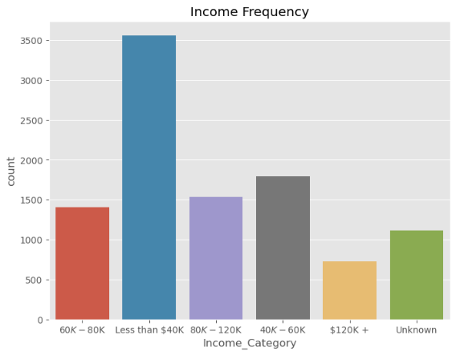
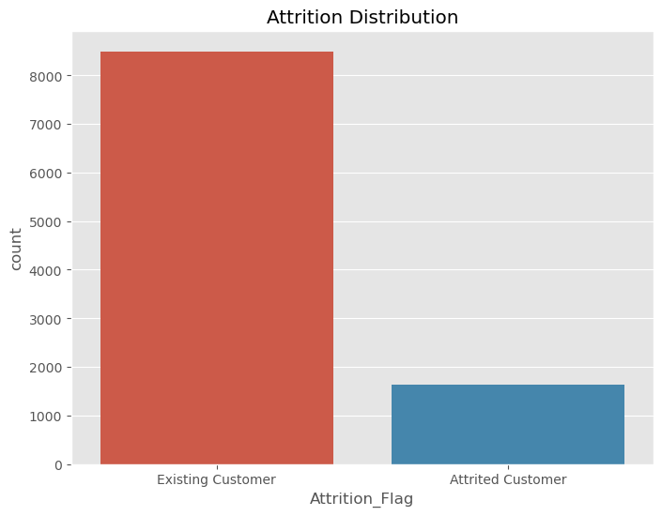
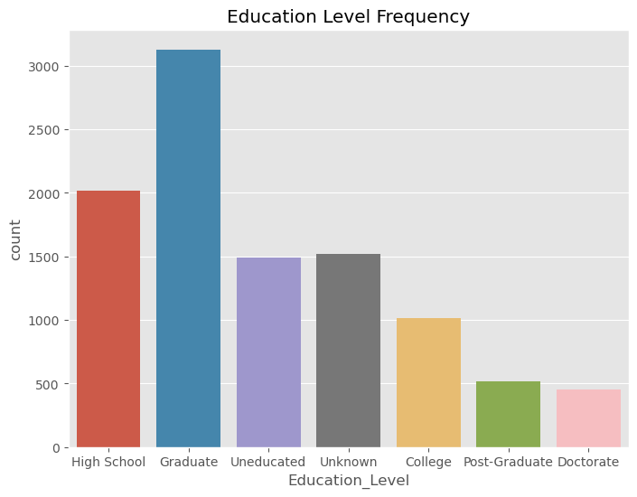
Exploratory Data Analysis

Slide 5
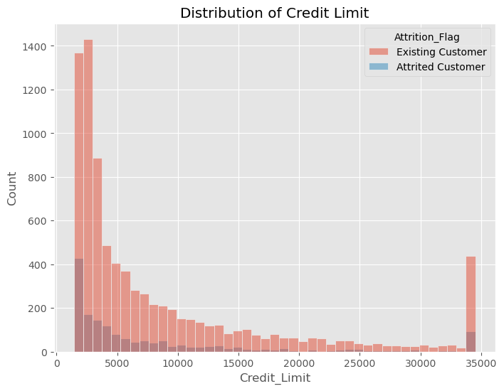
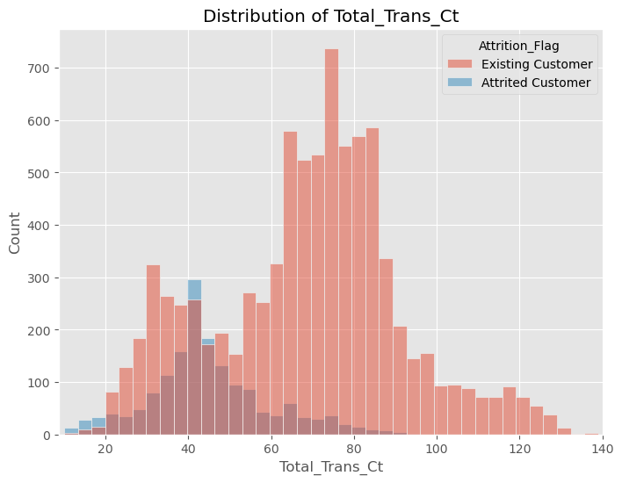
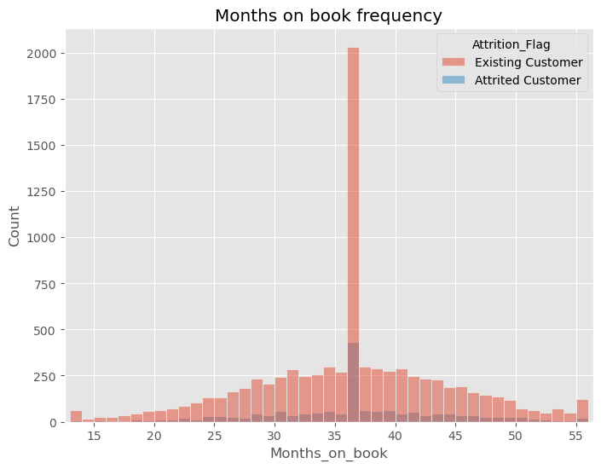
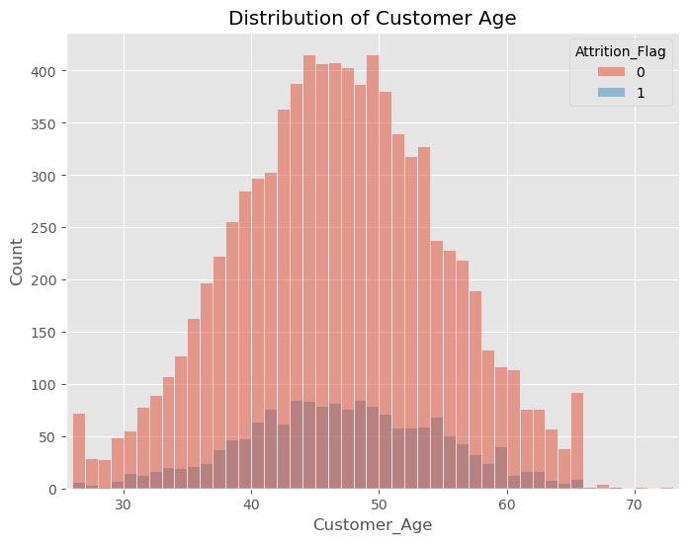

Slide 6
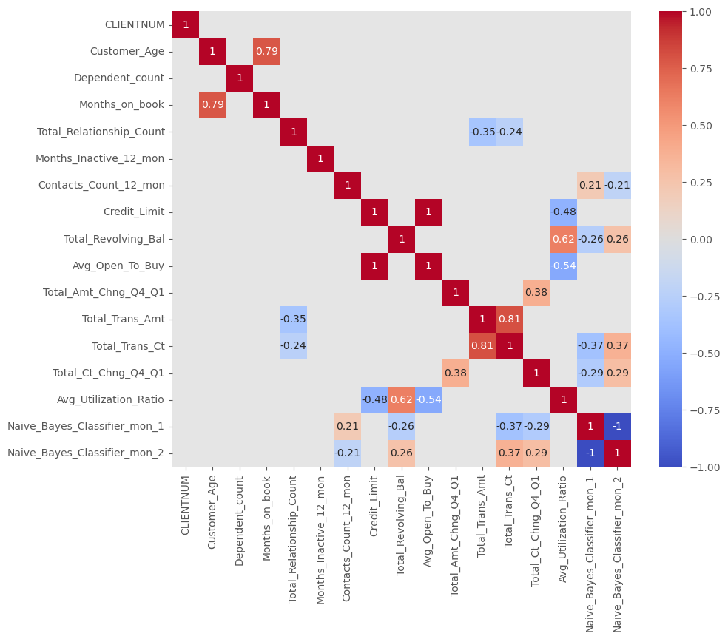

Slide 7
Modeling

Slide 8
Feature Engineering
We made interaction terms based on variables which had high correlations
Along with flags based off our visualizations
Column name | Type | Description
Interaction_1 | Numerical | Customer_Age * Months_on_book
Interaction_2 | Numerical | Total_Revolving_Bal * Avg_Utilization_Ratio
Interaction_3 | Numerical | Total_Trans_Amt * Total_Trans_Ct
Interaction_4 | Numerical | Avg_Utilization_Ratio * Avg_Open_To_Buy
Months_on_book_36_flag | Categorical | Flag for Months_on_book = 36
Credit_Limit_max_flag | Categorical | Flag for Credit_Limit = 34516
Total_Revolving_Bal_0_flag | Categorical | Flag for Total_Revolving_Bal = 0
Total_Revolving_Bal_max_flag | Categorical | Flag for Total_Revolving_Bal = 2517
Total_Trans_Ct_under_60 | Categorical | Flag for Total_Trans_Ct >= 60

Slide 9
Feature Selection
Used RFECV with 5 folds and f1 score as the evaluation metric
We ran through this sequence 5 times and kept track of the percentage of time each feature was selected in each model
Model | Number of features
Random Forest | 12
Ada Boost | 20
Gradient Boosting | 15
Hist Gradient Boost | 14
XG Boost | 13
Light GBM | 22
Cat Boost | 25

Slide 10
Hyper-Parameter Tuning
Model | Hyper-Parameters
Random Forest | n_estimators = 974 max_depth = 10 min_samples_split = 5 min_samples_leaf = 2
Ada Boost | learning_rate = 0.08 n_estimators = 438 max_depth = 3
Gradient Boosting | n_estimators = 958 max_depth = 3 min_samples_split = 8 min_samples_leaf = 6 learning_rate = 0.0547
Hist Gradient Boost | max_iter = 520 learning_rate = 0.1 l2_regularization = 0.1 min_samples_leaf = 7 max_leaf_nodes = 103 max_depth = 3 max_bins = 205
XG Boost | learning_rate = 0.02 n_estimators = 622 max_depth = 6 min_child_weight = 1 gamma = 0.003011 alpha = 3.305498 colsample_bytree = 0.51 subsample = 0.433741
Light GBM | n_estimators = 966 learning_rate = 0.02 num_leaves = 313 min_data_in_leaf = 37 min_child_weight = 0.07766 max_depth = 9 bagging_fraction = 0.65689 feature_fraction = 0.52445 lambda_l1 = 0.9316 lambda_l2 = 1.0916
Cat Boost | iterations = 699 learning_rate = 0.1 min_data_in_leaf = 154 depth = 7 random_strength = 0.76723 bagging_temperature = 0.34078 border_count = 79 l2_leaf_reg = 64
Used the Optuna framework to maximize the f1 score over 50 trials

Slide 11
Model Evaluation
Model | Accuracy score
Random Forest | .9637
Ada Boost | .9744
Gradient Boosting | .9736
Hist Gradient Boosting | .9734
XG Boost | .9716
Light GBM | .9749
Cat Boost | .9763

Slide 12
Ensemble Model
After identifying the optimal features and hyper-parameters for our dataset we picked out our top 5 performing models by accuracy score to ensemble
Final model scored an accuracy of .98 and a recall score of .95

Slide 13
Conclusion and Further Study
With the high level of accuracy our model was able to produce, we believe this model would be very beneficial to credit card companies or companies where customer attrition is a main priority
An area of further study we would be interested in looking at is specific causes customers to churn from the company if the data is available
Our dataset focuses on customers’ personal data but does not have any information on what customers could be dissatisfied with

